Slide 1
‘What does marriage migration regulation and practice reveal about tensions and congruencies between nation and state in Norway?’
Lecture 28 February 2013
Helga Eggebø

Slide 2
If you don’t do like people do in Norway, you aren’t accepted. You have to be Norwegian to live in Norway.

Slide 3
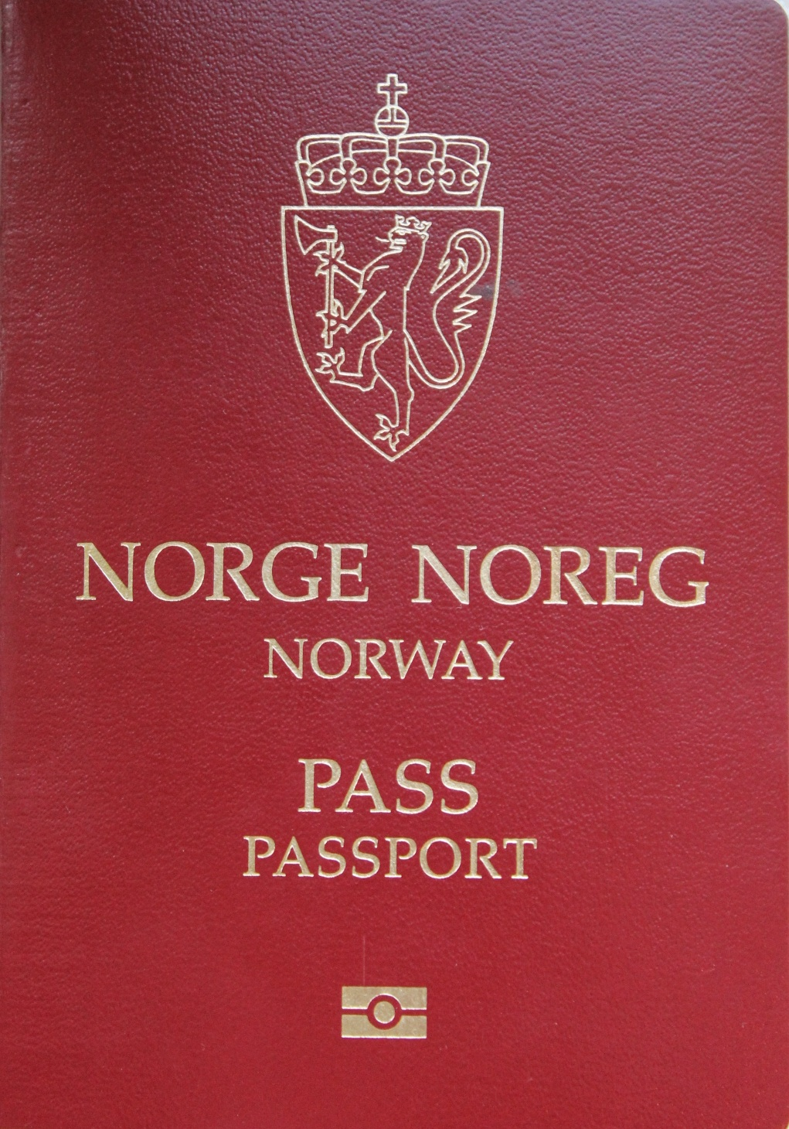
State
Organisation claiming control over territories and people.

Slide 4
Nation
Nation = state
A people with common cultural traits
Any group of people that define themselves as a nation

Slide 5
State Nation
The sphere of power The sphere of culture
Form of organisation Idea
Citizenship Ethnicity
Physical and legal borders Symbolic borders
Institutions People
Compulsory association Imagined community
Rational Emotional
A legal status A feeling of belonging

Slide 6
Norway – A National State
State formation
Assimilation
Ethnification

Slide 7
Nation
State

Slide 8
Becoming a Citizen
Jus sanguinis (blood)
Jus soli (soil)
Jus domicil (home)

Slide 9
Marriage Migration
242 440 NOK per year
Legally married
A real marriage
Identity

Slide 10
Just Like Everyone Else
Svein: We never applied. We just got married. We just signed the marriage papers just like everyone else. The district court judge arranged everything. We just mailed them the passport.
Katarina: Three weeks later, I had my residence permit. (…) We had to reply for renewal of the residence permit every year, and we did without problems. After three years we applied for permanent residence permit. Without problem. And finally, citizenship.

Slide 12
Russian Whore
Katarina: In the beginning, in particular in the beginning, people asked me if I was for sale. We were in the grocery store and if Svein wasn’t there they asked me what I would charge for sexual services. (…) I found that I had to fight to be allowed to be Ukrainian. Not Russian. Not a Russian whore, and all those nasty things. You had to prove it all the time, that you are just an ordinary worker, an ordinary person who would like to learn Norwegian.

Slide 13
Three Years Only
Katarina: When his mother was to congratulate us for getting married, she shook my hand and said: ‘well then, I hope it is not one of those three-years-marriages.’
Notes:
Katharina’s mother-in-law is indicating that their marriage is a marriage or convenience. A fake marriage. A bogus marriage set up in order to achieve residence permit in Norway. She is making this indication by referring the so-called three-year-rule. According to Norwegian regulations, migrants can apply for a permanent residence permit after three years of legal residence. Before achieving permanent residency, the permit depends on the marriage. If the couple divorce, the migrant will loose the residence permit. The political justification for the three-year-rule is to prevent marriages of convenience. According to both the immigration administration, as well as marriage migrants themselves, some people are more prone to suspicion than others. Men from Turkey, Pakistan and North-Africa, women from Russia and Eastern-Europe and both men and women from Somalia seem to evoke suspicion more frequently than others. For the sake of Russian women, prostitution and marriage of convenience seem collapse into one stereotype: Whether you marry for residency or you sell sex is same same. Either way, you are a whore.

Slide 14
Russians Stuff
Svein: My mother was very critical, right. She tried to make life difficult for us all the time. For example, she would tell Katarina what an ugly language she spoke when she was talking to our oldest son. It was this norwegianisation all the time. For example, we had some glasses in the cupboard. ‘Why do you have that Russian stuff here?’ they would ask.

Slide 15
Too Norwegian
Katarina: She complained that everything in our home was too Norwegian. That I had become too Norwegian. And his mother claimed we were all too Ukrainian. And then they reigned one period each. Changed all the cups, pots and glasses in the house. (…) My mother saw me as a traitor leaving off my own culture.

Slide 16
Repeated Norwegianization
Svein: My mother is very conscious about the importance of being Norwegian. (…) If you ask my mother, she would say that she is not Sami, but Norwegian. Even though she is Sami. My mother was born in the early 50s and attended school during the most intense period of norwegianisation. Her parents wouldn’t teach her the Sami language.
Katarina: It is similar to what I experienced. I didn’t speak Ukrainian to our oldest son because everyone said that the language I spoke was so ugly. You had to talk Norwegian only. Even though you wanted to keep the language.

Slide 19
Do You Speak Norwegian?
Svein: Even if you have a Norwegian University degree, foreigners are always questioned about their Norwegian skills.
Katarina: You have to defend your papers all the time. They clearly see from the papers that you have a bachelor’s degree. But no matter how well you know Norwgian, they are always putting you down. It really affects you when they ask these things. My skills in Norwegian are well documented, with exams from the University College with a good grade and all. It should be unnecessary to humiliate you like that.

Slide 20
Saving the Russians
Svein: If you look at it cynically: what saved the Northerners (people from the three northernmost regions of Norway) in Oslo during the 60s was the arrival of the Pakistanis. Then the Oslo people had somebody else to pay hell. This could be what saves the Russians in Finnmark. The arrival of asylum-seekers.
Katarina: Last year, there was a lot of writing in the papers about asylum-seekers, and then there are less focus on us (the Russians and Eastern-Europeans). We had a year off!

Slide 21
Nation
State

Slide 23
Nation
State

Slide 24
Thank you for coming!
Welcome back tomorrow 10.15

